Slide 1
Image Caption Bot
Apoorv Kumar

Slide 2

Contents
Introduction
Motivation
Research Work
Libraries
Methodology
Results

Slide 3
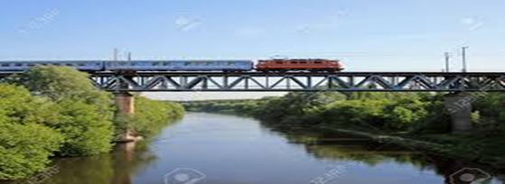
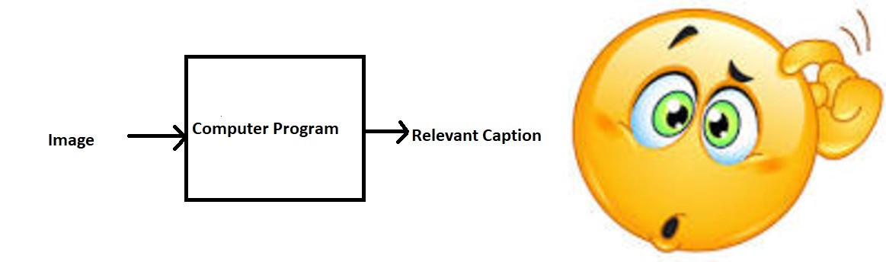
Introduction
What do you see in this Picture?
Well some of you might say “A Train on a bridge”, some may say “Bridge on river” and yet some others might say “Plants near the river ”Definitely all of these captions are relevant for this image and there may be some others also. But the point I want to make is; it’s so easy for us, as human beings, to just have a glance at a picture and describe it in an appropriate language.
Can we write a computer program for that?
Just prior to the recent development of Deep Neural Networks this problem was inconceivable even by the most advanced researchers in Computer Vision. But with the advent of Deep Learning this problem can be solved very easily if we have the required dataset.

Slide 4
Motivation
This problem is really important to many real word scenarios which highly motivated me to continue with this idea :
We can create a product for the blind people which will guide them travelling on the roads without the support of anyone else. We can do this by first converting the scene into text and then the text to voice. Both are now famous applications of Deep Learning.
Automatic Captioning can help in making good Google Image Search experience, as then every image could be first converted into a caption and then search can be performed based on the caption.
This Model can also be used in self driving cars. In the self driving cars we can use this Image caption bot which we detect the obstacle encountered in the path of self driving car.
CCTV cameras are everywhere today, but along with viewing the world, if we can also generate relevant captions, then we can raise alarms as soon as there is some malicious activity going on somewhere.

Slide 5
Libraries
pandas
numpy
Matplotlib
keras
re
time
pickle
Opencv
Nltk

Slide 6
Related Work
Ref. No. | Author | Title of Research Paper/Article | Comments
[1] | Jianhui Chen Wenqiang Dong Minchen Li | Image Caption Generator Based On Deep Neural Networks | They generate multiple sentences using Beam Search. The experiments show that the modified method can generate captions comparable to the-state-of-the-art methods with less training memory
[2] | Oriol Vinyals Alexander Toshev Samy Bengio Dumitru Erhan | A Neural Image Caption Generator | presented a generative model based on a deep recurrent architecture that combines recent advances in computer vision and machine translation
[3] | Haoran Wang Yue Zhang Xiaosheng Yu | An Overview of Image Caption Generation Methods | The paper discusses the advantages and the shortcomings of these methods providing the commonly used datasets and evaluation criteria in this field.
[4] | Luowei Zhou1 Hamid Palangi2 Lei Zhang3 | Unified Vision-Language Pre-Training for Image Captioning and VQA | This paper presents a unified Vision-Language Pre-training (VLP) model.

Slide 7
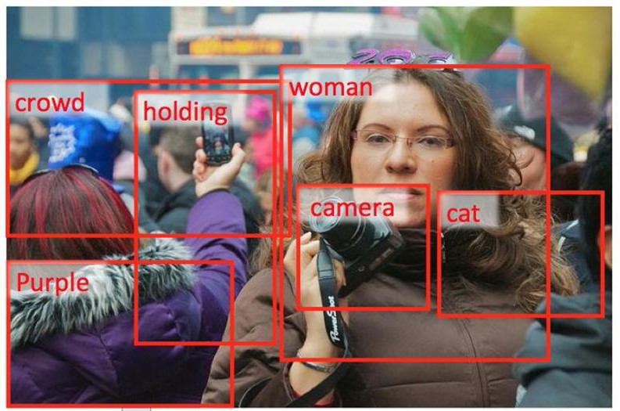
Methodology
Data collection
Understanding the data
Data Cleaning
Loading the training set
Data Preprocessing — Images
Data Preprocessing — Captions
Data Preparation using Generator Function
Word Embeddings
Model Architecture
Dataset
collection
Understnding
Datast
Data
Cleanin
Loading
Training set
Data Preprocessing
Data
Preparation
Model

Slide 8

1.Dataset collection
There are many open source datasets available for this problem, like Flickr 8k (containing 8k images), Flickr 30k (containing 30k images), MS COCO (containing 180k images), etc. For this problem I have used Flickr 8k dataset due to unavailability of high power GPU .This dataset is provided by the University of Illinois at Urbana-Champaign.Also training a model with large number of images may not be feasible on a system which is not a very high end PC/Laptop.This is dataset is quite feasible to work on .Dataset is approximately around 1.14GB.

Slide 9
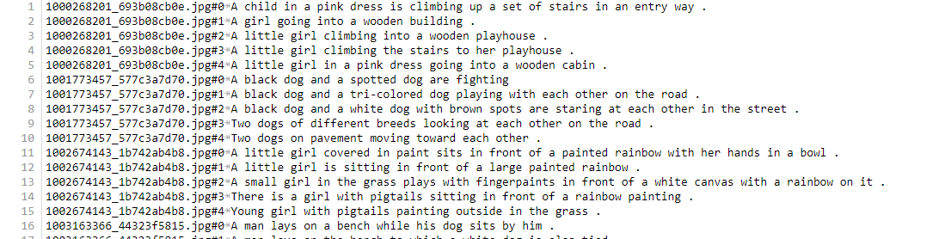
2. Understanding the Dataset
The dataset contains three folders names as images flickrtextdata and flickr8k textfiles. FlickrTextdata has two files for training and testing in which the image id for each image is written.This dataset contains 8000 images each with 5 captions as an image can have multiple captions, all being relevant simultaneously.This dataset is further divided into three parts.Training set has 6000 images,validation and test set has 1000 images simultaneously.One of the files is “Flickr 8k.token.txt” which contains the name of each image along with its 5 captions.Below is the dataset screenshot.

Slide 10
3. Data Cleaning
When we deal with text, we generally perform some basic cleaning like lower-casing all the words (otherwise“hello” and “Hello” will be regarded as two separate words), removing special tokens (like ‘%’, ‘$’, ‘#’, etc.), eliminating words which contain numbers (like ‘hey199’, etc.).
In sentiment analysis we also remove the stopwords but we will not remove stopwords here because it will completely change the sense of sentence.For eg if dog is running it will not able to predict is which will be a senseless sentence.we will also avoid stemming here because running and run will also change the meaning of predicted sentence so we have to be precise.
This all will reduce my vocab size after removing numbers and punctuations marks using regular expression. Reducing vocab size have great advantage because reducing the vocab size will reduce dense layer at end which will ultimately lead to less number of parameters .
I Created a vocabulary of all the unique words present across all the 8000*5 (i.e. 40000) image captions in the data set from my cleaned descriptions captions. We have now 8424 unique words across all the 40000 image captions.I then rejected all those words which have frequency less than 10. 10 is my threshold frequency for this project.
Text Preprocessing

Slide 11
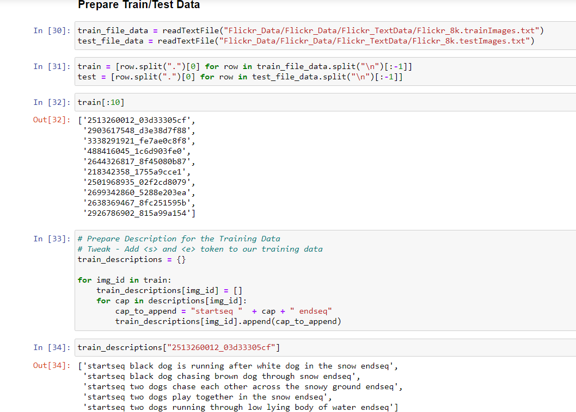
4.Loading Training set
The text file “Flickr_8k.trainImages.txt” contains the names of the images that belong to the training set.So I load these names.I load the descriptions of these images from “descriptions.txt”.However, when I load them, I added two tokens in every caption ‘startseq’ , This is a start sequence token which will be added at the start of every caption and ‘endseq’ This is an end sequence token which will be added at the end of every caption. startseq and endseq is added so that while training it from RNN the model can easily predict the starting and ending of the sequence.

Slide 12
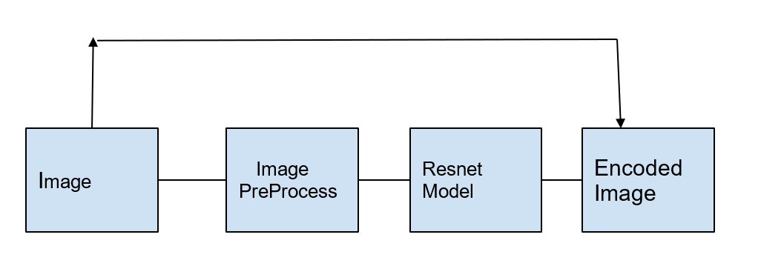
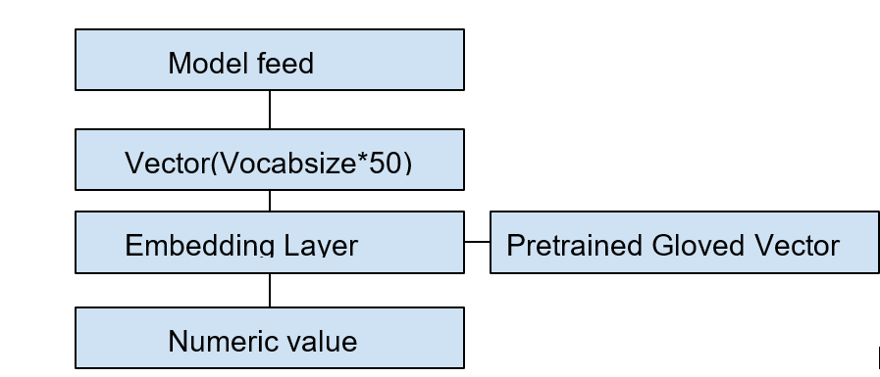
5. Data Preprocessing
Since there are two types of data which we have to feed in the final mlp layer so preprocessing for both the data will be different :
Data Preprocessing For Images (Image feature Extraction)
Data Preprocessing captions
Data Preprocessing (Images)
Data Preprocessing(Captions)

Slide 13
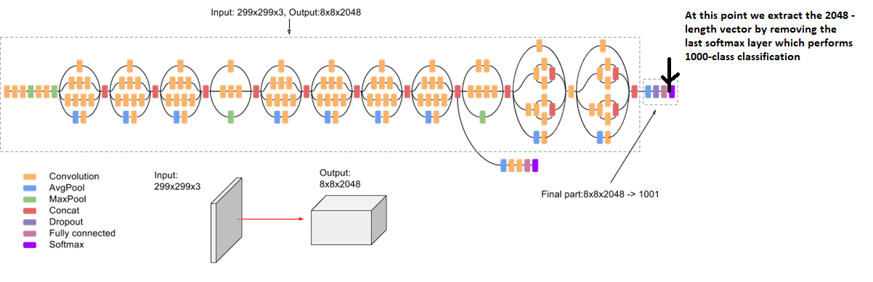
5.1 Data Preprocessing for images
(Image feature Extraction)
We are using a pre-trained model to extract the image features.Thai is an imagenet model named ad ResNet-50. ResNet-50 is a convolutional neural network that is 50 layers deep. We can load a pre trained version of the network trained on more than a million images from the ImageNet database . The pretrained network can classify images into 1000 object categories, such as keyboard, mouse, pencil, and many animals. As a result, the network has learned rich feature representations for a wide range of images. The network has an image input size of 224-by-224.

Slide 14
We need to convert every image into a fixed sized vector which can then be fed as input to the final Image caption generator model. For this purpose, we opt for transfer learning by using the ResNet-50 model.Our purpose here is not to classify the image but just get fixed-length informative vector for each image.Hence, we just remove the last softmax layer from the model and extract a 2048 length vector (bottleneck features) for every image.
we are not going to use this resnet model but we are using this only for the feature extraction.After this we will use functional API to make a new model in which we will use input as same given to resent and output will be the second last layer of resnet.This is done because we does not require the dense layer we only require the feature vector of the images.
After this we encode our data in which we first preprocess the image and than pass it from the model as input and than store it as a feature vector.
Finally we have to reshape our feature vector into 4d tensor because the input given to model is in the form of batches like this (1,224,224,3) and currently it is 3d.while preprocessing we also have to take care of Normalisation in which we use preprocessinput as function of keras. This preprocessinput is done by resnet because resnet is trained on this kind of input,Pixels are clipped in Range 0 to 255 basically it has subtracted the channel mean from all of its pixels.

Slide 15
5.2 Data Preprocessing Captions
Stating simply, we will represent every unique word in the vocabulary by an integer (index). we have 1845 unique words in the corpus and thus each word will be represented by an integer index between 1 to 1845.
I am constructing two dictionaries that is word_to_idx storing word to index and idx_to_word storing word corresponding to every index.Since we would be doing batch processing we need to make sure that each sequence is of equal length. Hence we need to append 0’s (zero padding) at the end of each sequence. So we will append those many numbers of zeros which will lead to every sequence having a max length in all the captions which is 35.
Since we are using Transfer learning instead of training directly from the scratch from embedding layer.so we will use Glove vector which will convert each vector into 50 dimensional vector. Every word (or index) will be mapped (embedded) to higher dimensional space through one of the word embedding techniques.we will map the every word (index) to a 50-long vector and for this purpose, we will use a pre-trained GLOVE Model.GloVe is an unsupervised learning algorithm for obtaining vector representations for words.
Training is performed on aggregated global word-word co-occurrence statistics from a corpus, and the resulting representations showcase interesting linear substructures of the word vector space. Now, for all the 1845 unique words in our vocabulary, we create an embedding matrix which will be loaded into the model before training.so we will make a matrix which we have to input in the final model whose shape will be 1845*50 this will get directly feeded into the model for training.

Slide 16
6 Data Preparation using Generator Function
This is one of the most important steps in this project. Machine can not output a complete sentence in once.The problem is dealt like a supervised machine learning problem where we will be using image name as input and it will produce a word corresponding to the image and also corresponding to the words already predicted in the sentence and will predict till endseq is not approached and all combined will lead to form caption starting from startseq and ending at endseq. We will prepare the data in a manner which will be convenient to be given as input to the deep learning model.
The way in which the caption is predicted::
For the first time, we provide the image vector and the first word as input and try to predict the second word, i.e.:
Input = Image_1 + ‘startseq’; Output = ‘the’
Then we provide image vector and the first two words as input and try to predict the third word, i.e.:
Input = Image_1 + ‘startseq the’; Output = ‘cat’
And so on…

Slide 17
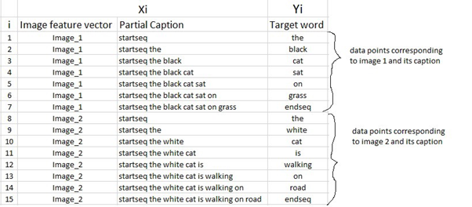
Supervised Problem

Slide 18
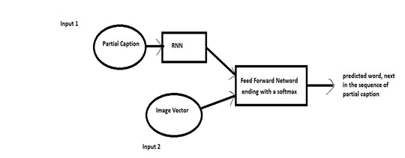
Model Architecture

Slide 19
Images
Input-(shape 2048)
Dropout(0.3)(Input)
Denslayer(256,relu)
(Image is converted in 256 Dimesnioanl vector and it will be input to the final MLP).
Text
Input-(shape(maxlen=35))
inp1=Embedding Layer(Input)
Dropout(0.3)(inp1)
Denselayer(256)LSTNLayers
(Text is also converted in 256 Dimensinal vector and will get feeded into MLP)
Input to MLP(Which is decoder here)
Concatenation = Image(256)+Text(256)
Out1 = Denselayer(256,Relu)(concatenation)
Now both images and partial caption is compressed in 256 neurons
Outputs = (denselayer = vocabsize , activation = softmax)(out1)
(Now it will give probablity distribution for the predicted next word from all the words of vocab size)
Feeding input and output to Model for final training

Slide 20
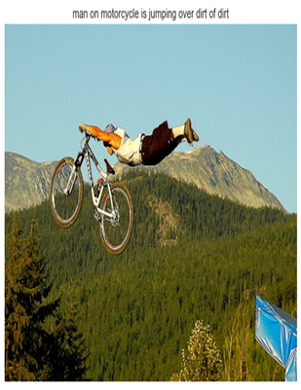
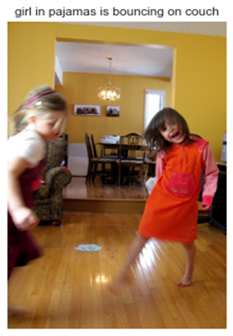
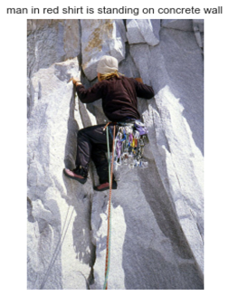
Results Obtained

Slide 21
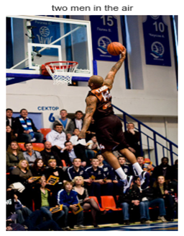
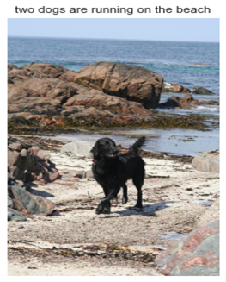
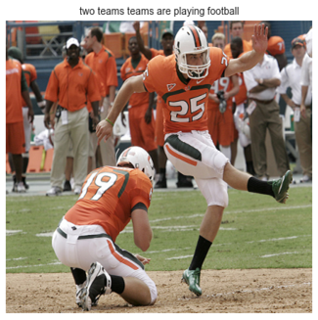

Slide 22

In my Image caption generator model, I successfully performed both the training and development part of the project in which I successfully cleaned the data and then preprocessed both image data and text data. After the training I saved my model weights and those weights were used to generate the caption for images. Images was able to generate the captions which were highly relevant.

Slide 23
References
1 Chen, Jianhui, Wenqiang Dong, and Minchen Li. "Image Caption Generator Based On Deep Neural Networks." (2014).
2 Vinyals, Oriol, et al. "Show and tell: A neural image caption generator." Proceedings of the IEEE conference on computer vision and pattern recognition. 2015.
3 Wang, Haoran, Yue Zhang, and Xiaosheng Yu. "An Overview of Image Caption Generation Methods." Computational Intelligence and Neuroscience 2020 (2020).
4 Zhou, Luowei, et al. "Unified Vision-Language Pre-Training for Image Captioning and VQA." AAAI. 2020.
5..https://towardsdatascience.com/image-captioning-with-keras-teaching-computers-to-describe-pictures-c88a46a311b8

Slide 24


